Slide 1
Loan Prediction using machine learning
TEAM MEMBERS : UNDER THE GUIDANCE OF :
T. VARUN KUMAR REDDY 2451-20-737-123 M. Prathyusha, Assis. Prof.
P. SAI NITHIN 2451-20-737-124 Department of I.T.
K. SAKETH 2451-20-737-130

Slide 2
Abstract:
Loan approval prediction is a critical task in the financial industry, as lenders need to assess the risk of granting loans to applicants. Machine learning techniques can be used to predict the likelihood of loan approval based on various features, such as credit history, income, employment status, and loan amount. In this task, the dataset is split into training and testing sets, and a machine learning algorithm is trained on the training set to learn the relationship between the features and loan approval status. The trained model is then evaluated on the testing set to determine its performance in predicting loan approval status. Various machine learning algorithms such as logistic regression, decision trees, random forests, and support vector machines can be used for loan approval prediction. The accuracy of the prediction model can be further improved by feature engineering, hyperparameter tuning, and ensemble learning techniques.

Slide 3
Introduction:
Loan approval prediction is a crucial task for banks and financial institutions, as it determines the risk of default and the potential for financial loss. Traditionally, loan approval decisions have been made manually by underwriters, which can be time-consuming and prone to human bias.
However, with the emergence of machine learning, loan approval prediction has become faster and more objective. By training machine learning models on historical loan data, banks and financial institutions can gain insights into the factors that contribute to loan approvals and identify patterns that may indicate a higher risk of default.
Machine learning algorithms, such as logistic regression, decision trees, and support vector machines, can be used to predict loan approval decisions based on various features related to loan applicants, such as credit history, income, debt-to-income ratio, employment status, and more. These models can process large amounts of data quickly and accurately, providing a more efficient and accurate way to assess credit risk.
Overall, loan approval prediction using machine learning is a promising approach that has the potential to improve the efficiency and accuracy of loan approval decisions while reducing the risk of financial loss.

Slide 4
Problem statement:
We are building a model to predict the approval of loan by using various machine learning algorithms such as logistic regression , decision trees, random forests.

Slide 5
Literature Survey
NAME | YEAR | AUTHOR NAME | ALGORITHM / TECHNIQUE USED | ADVANTAGES | LIMITATIONS
Feature selection for loan approval prediction using machine learning algorithms | 2022 | A.S. Alghamdi and W.S. Alfares | Logistic Regression, Decision Tree, Random Forest, KNN, SVM, and ANN | Demonstrated that feature selection techniques can improve the accuracy and reduce the computational cost of loan approval prediction models | Used only one dataset for evaluation
Loan approval prediction using deep learning models | 2022 | S.M.J. Alzahrani, A.A. Almalaq, And M.O. Aljaafari | Convolutional Neural Network (CNN), Long Short-Term Memory (LSTM), and Hybrid models combining CNN and LSTM | Demonstrated that deep learning models can achieve high accuracy for loan approval prediction | Used only one dataset for evaluation, deep learning models require more computational resources than traditional machine learning models

Slide 6
NAME | YEAR | AUTHOR NAME | ALGORITHM / TECHNIQUE USED | ADVANTAGES | LIMITATIONS
An empirical comparison of machine learning algorithms for loan approval prediction | 2022 | S.C. Dey and R.R. Debnath | Logistic Regression, Decision Tree, Random Forest, KNN, SVM, ANN, and XGBoost | Identified XGBoost as the most accurate model for loan approval prediction | Used multiple datasets for evaluation, including a large real-world dataset
Loan approval prediction using machine learning and fuzzy logic | 2021 | A.N. Anwar and M.A. Hossain | Decision Tree, Random Forest, KNN, SVM, and Fuzzy Logic | Demonstrated that incorporating fuzzy logic with machine learning algorithms improved the accuracy of loan approval prediction compared to individual models | Used only one dataset for evaluation

Slide 7
NAME | YEAR | AUTHOR NAME | ALGORITHM / TECHNIQUE USED | ADVANTAGES | LIMITATIONS
Loan approval prediction using machine learning algorithms | 2021 | H.V.Shetty and S.S. Shetty | Logistic Regression, Decision Tree, Random Forest, KNN, SVM, and ANN | Identified Random Forest as the most accurate model for loan approval prediction | Used only one dataset for evaluation
Loan approval prediction using machine learning techniques: A systematic literature review | 2020 | Ahmad Al- Qaraghuli, Ali Alsheikhi, And Ayad Alkaim | Logistic Regression, Decision Tree, Random Forest, KNN, SVM, Naïve Bayes | Identified Random Forest and SVM as the most accurate models for loan approval prediction | Used only three datasets for evaluation, limiting generalizability of findings

Slide 8
Existing system:
This model is trained on historical loan data to learn patterns and make predictions about whether a new loan applicant is likely to default or not. The system may also use various algorithms such as logistic regression, decision trees, or random forests to make predictions. The output of the model is a probability score that indicates the likelihood of loan approval. Based on this score, the lender can decide whether to approve the loan or not. However, the accuracy and reliability of the system depend on the quality of the data used to train the model, the selection of appropriate features, and the choice of the algorithm used for predictions.
DRAWBACKS OF EXISTING SYSTEM :
Limited data
Biased training data
Lack of interpretability
Overfitting
Lack of transparency
Costly implementation

Slide 9
PROPOSED SYSTEM:
The proposed system uses a machine learning approach to predict loan approval. The system will utilize historical data on loan applications and their outcomes to train a model that can accurately predict whether a new loan application is likely to be approved or not. The model will take into account various factors such as credit score, income, employment history, and other relevant information to make its prediction. The system will be designed to be user-friendly, with a simple interface that allows users to input their information and receive a quick decision on their loan application. It is hoped that the system will reduce the time and resources required for manual loan processing and improve the accuracy of loan decisions.

Slide 10
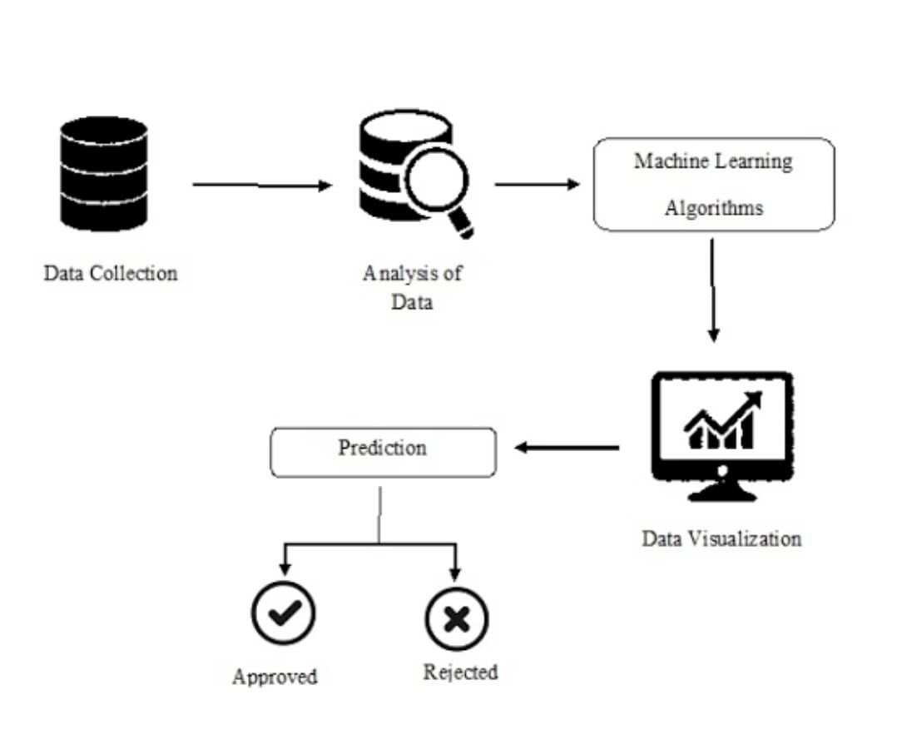
PROPOSED SYSTEM

Slide 11
MODULE SPLIT-UP:
1. Data collection and preprocessing:
In this module, you would collect loan application data from various sources such as databases, spreadsheets, or web APIs. Once you have collected the data, you would clean it by removing any irrelevant or duplicated data, handling missing values, and converting categorical variables to numerical variables using techniques such as one-hot encoding. You would also normalize the numerical variables to ensure that they are on the same scale.
2. Feature selection and engineering:
In this module, you would select the most relevant features that could impact loan approval. These could include variables such as credit score, loan amount, employment history, and debt-to-income ratio. You would also engineer new features by combining existing features or creating new ones based on domain knowledge. For example, you could create a new feature that calculates the ratio of the loan amount to the borrower's income.
3. Model selection and training:
In this module, you would select the appropriate machine learning algorithm(s) to train the model(s) using the
preprocessed data. You could experiment with different algorithms such as logistic regression, decision trees, or random forests to see which one performs the best. Once you have selected an algorithm, you would train the model(s) on the data and adjust the hyperparameters to optimize the model performance.

Slide 12
MODULE SPLIT-UP :
4. Model evaluation and optimization:
In this module, you would evaluate the performance of the trained model(s) using various metrics such as accuracy, precision, recall, and F1 score. You would also optimize the model(s) by tweaking hyperparameters or trying different algorithms to improve performance.
5. Deployment and monitoring:
In this module, you would deploy the model(s) into a production environment and monitor its performance over time. You would set up an API endpoint to make predictions, log the predictions, and monitor system metrics such as response time and error rates. You would also periodically retrain the model(s) with new data to ensure that they remain accurate and up-to-date.This modular approach can help you break down the loan approval prediction problem into smaller, more manageable pieces, making it easier to develop and maintain a high-quality machine learning solution.

Slide 13
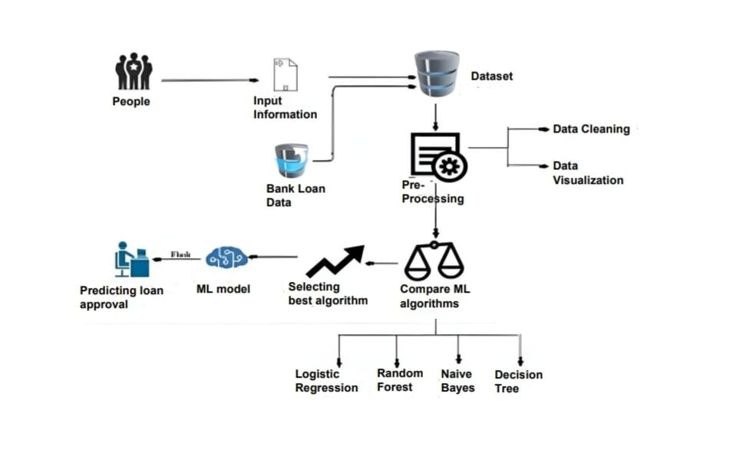
ARCHITECTURE

Slide 14
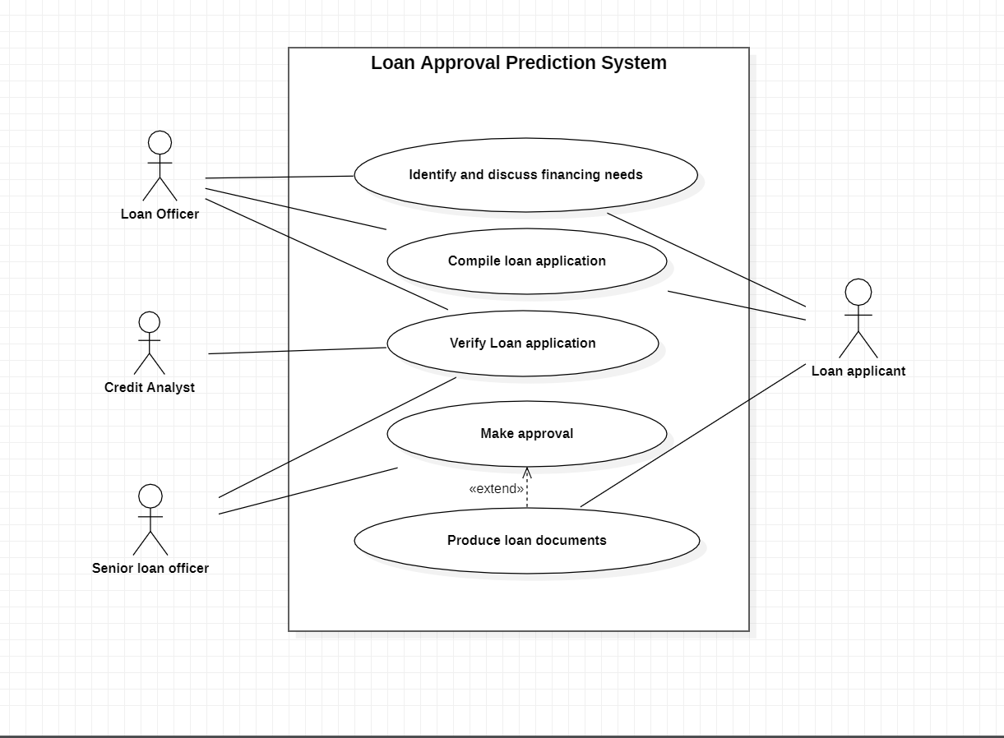
Use case diagram:

Slide 15
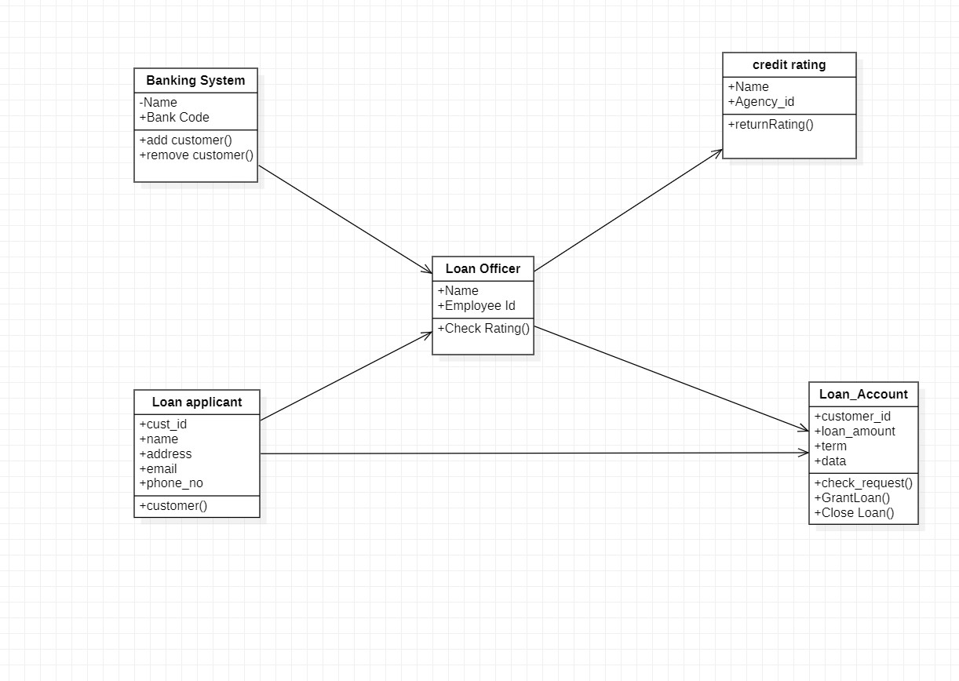
Class diagram:

Slide 16
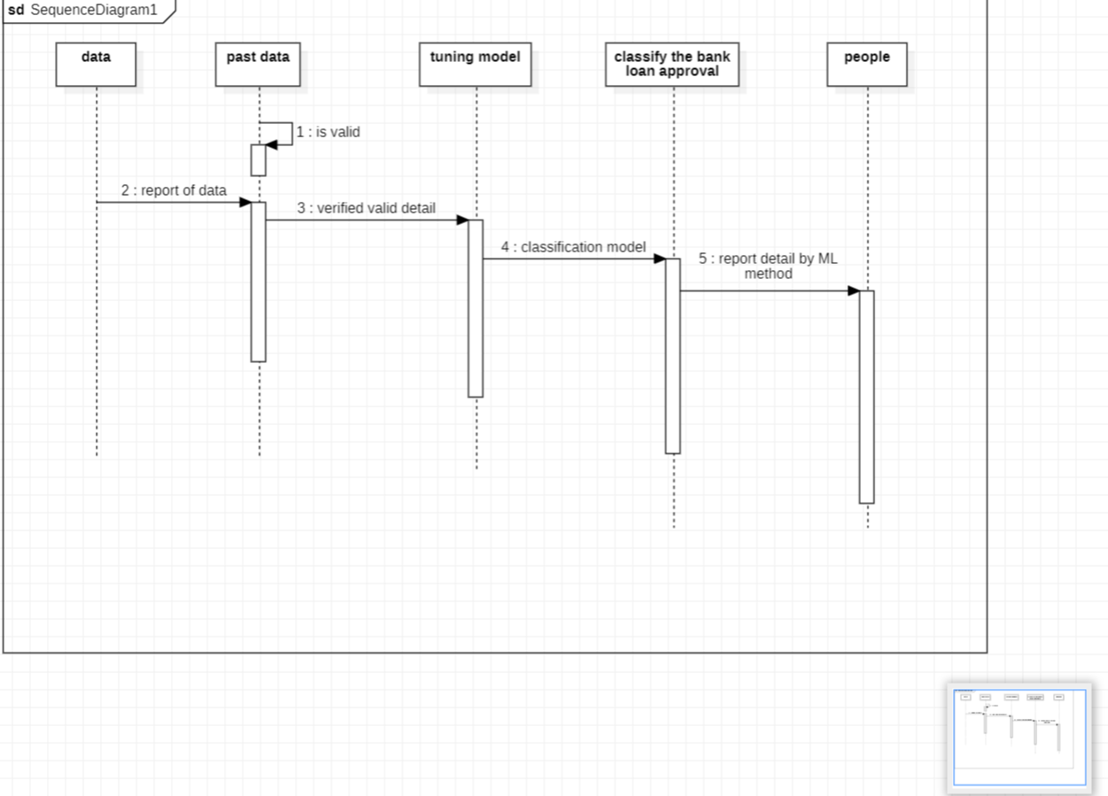
Sequence diagram:

Slide 17
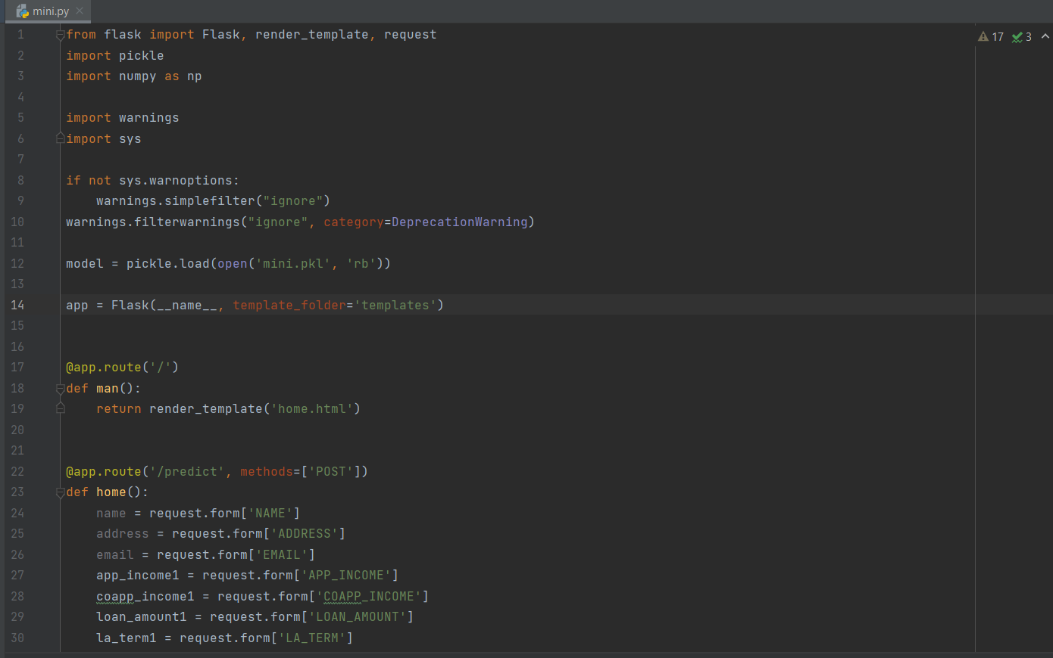
Implementation FLASK CODE :

Slide 18
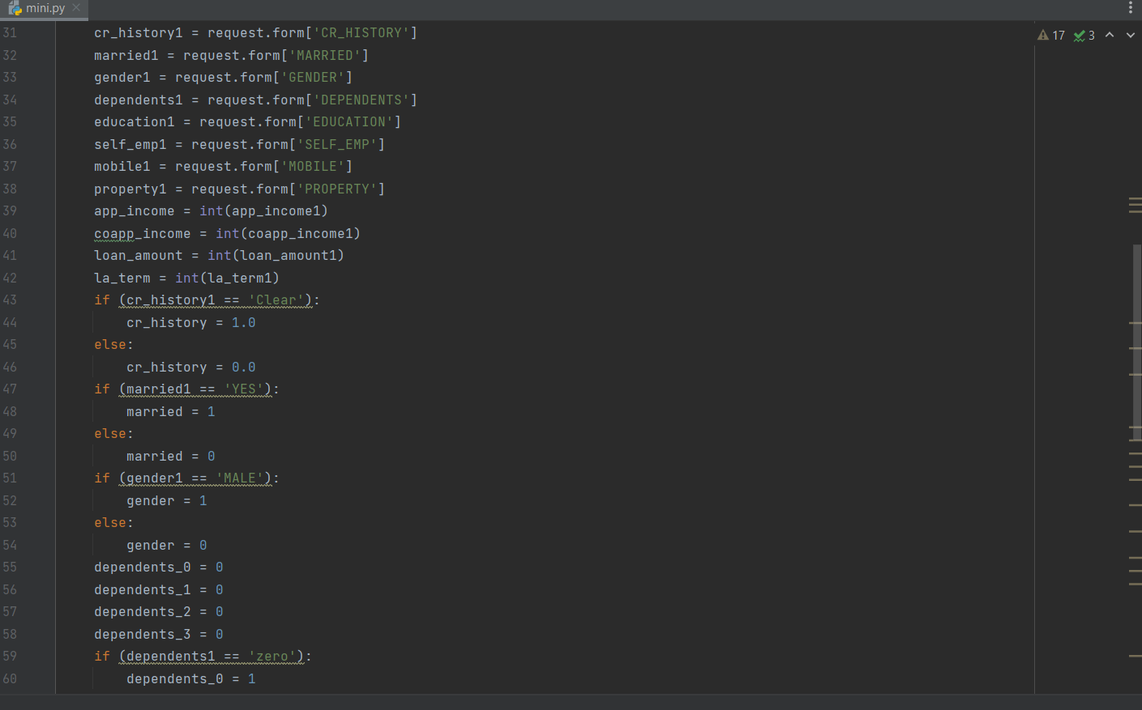

Slide 19
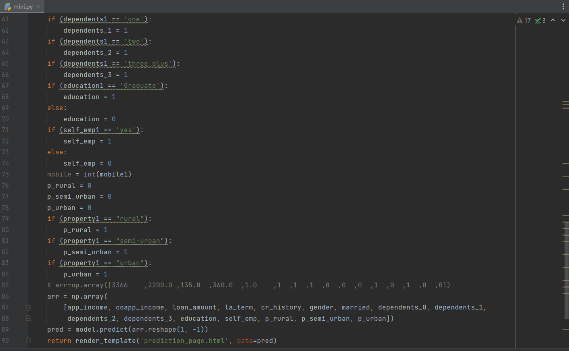

Slide 20
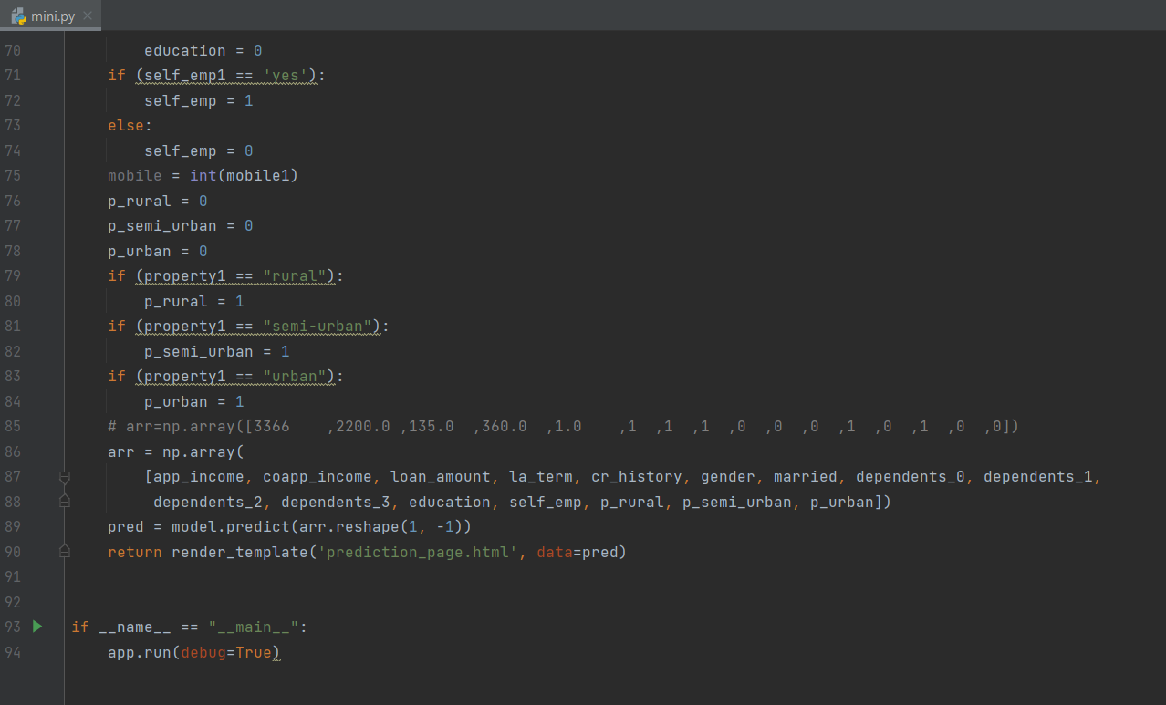

Slide 21
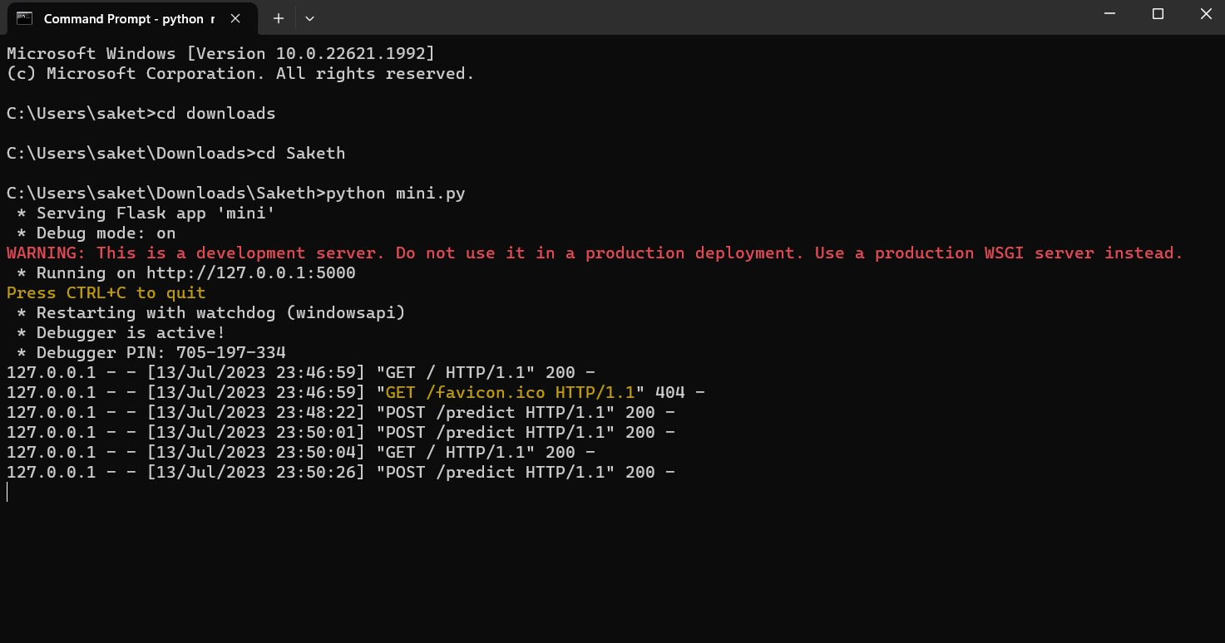
Output:

Slide 22
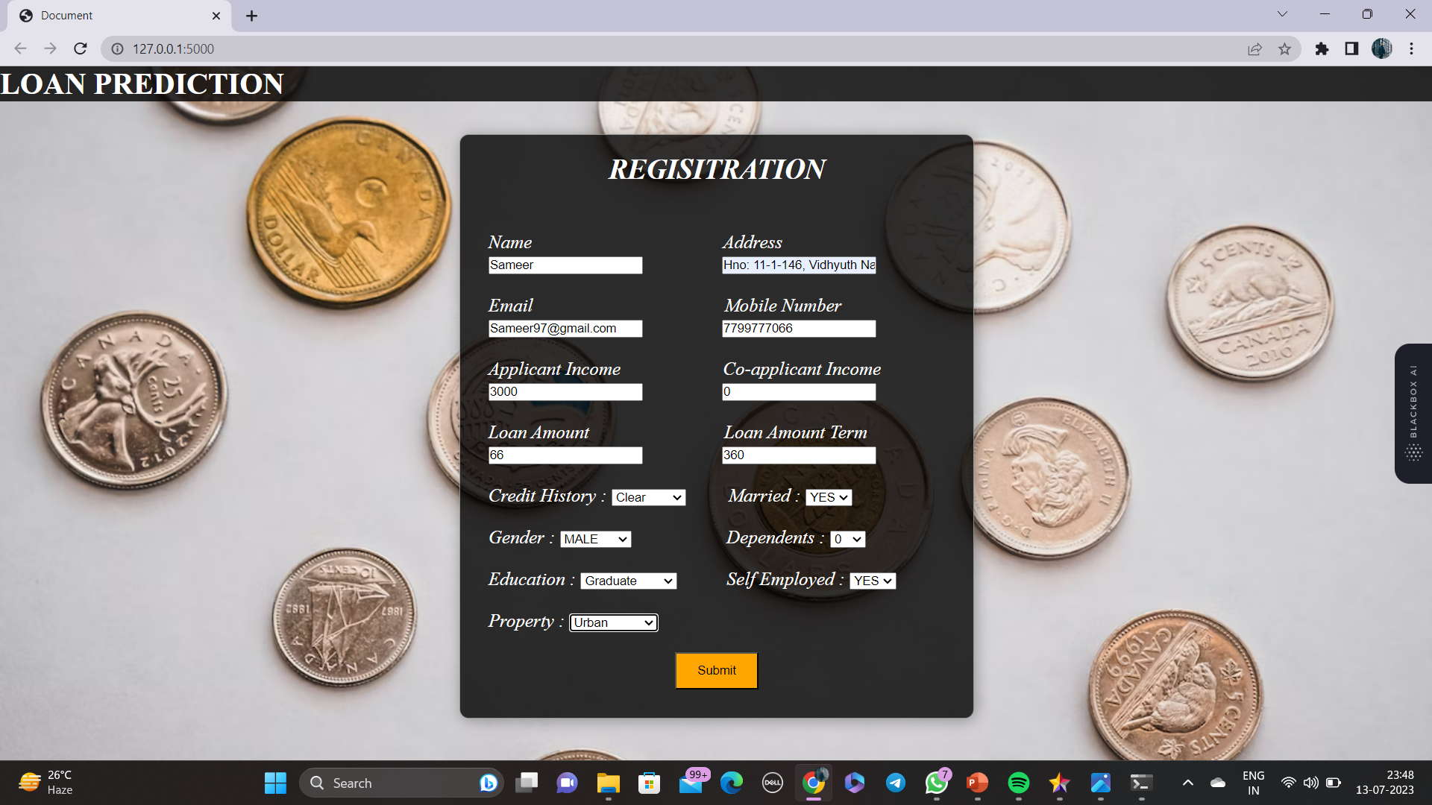

Slide 23
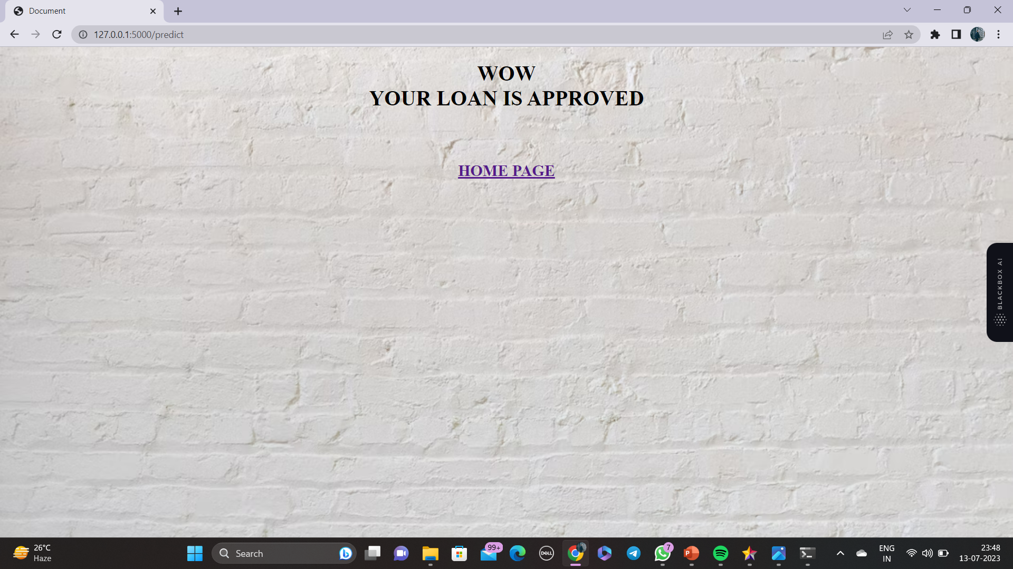

Slide 24
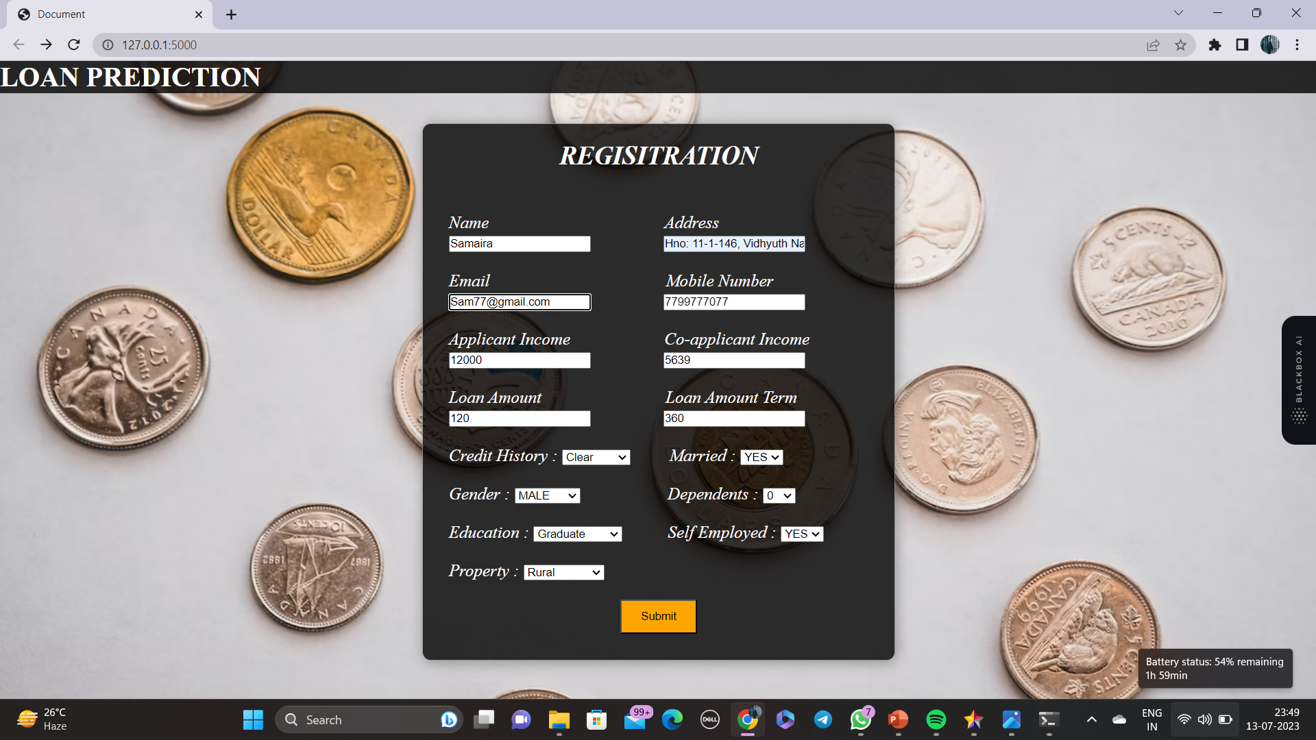

Slide 25
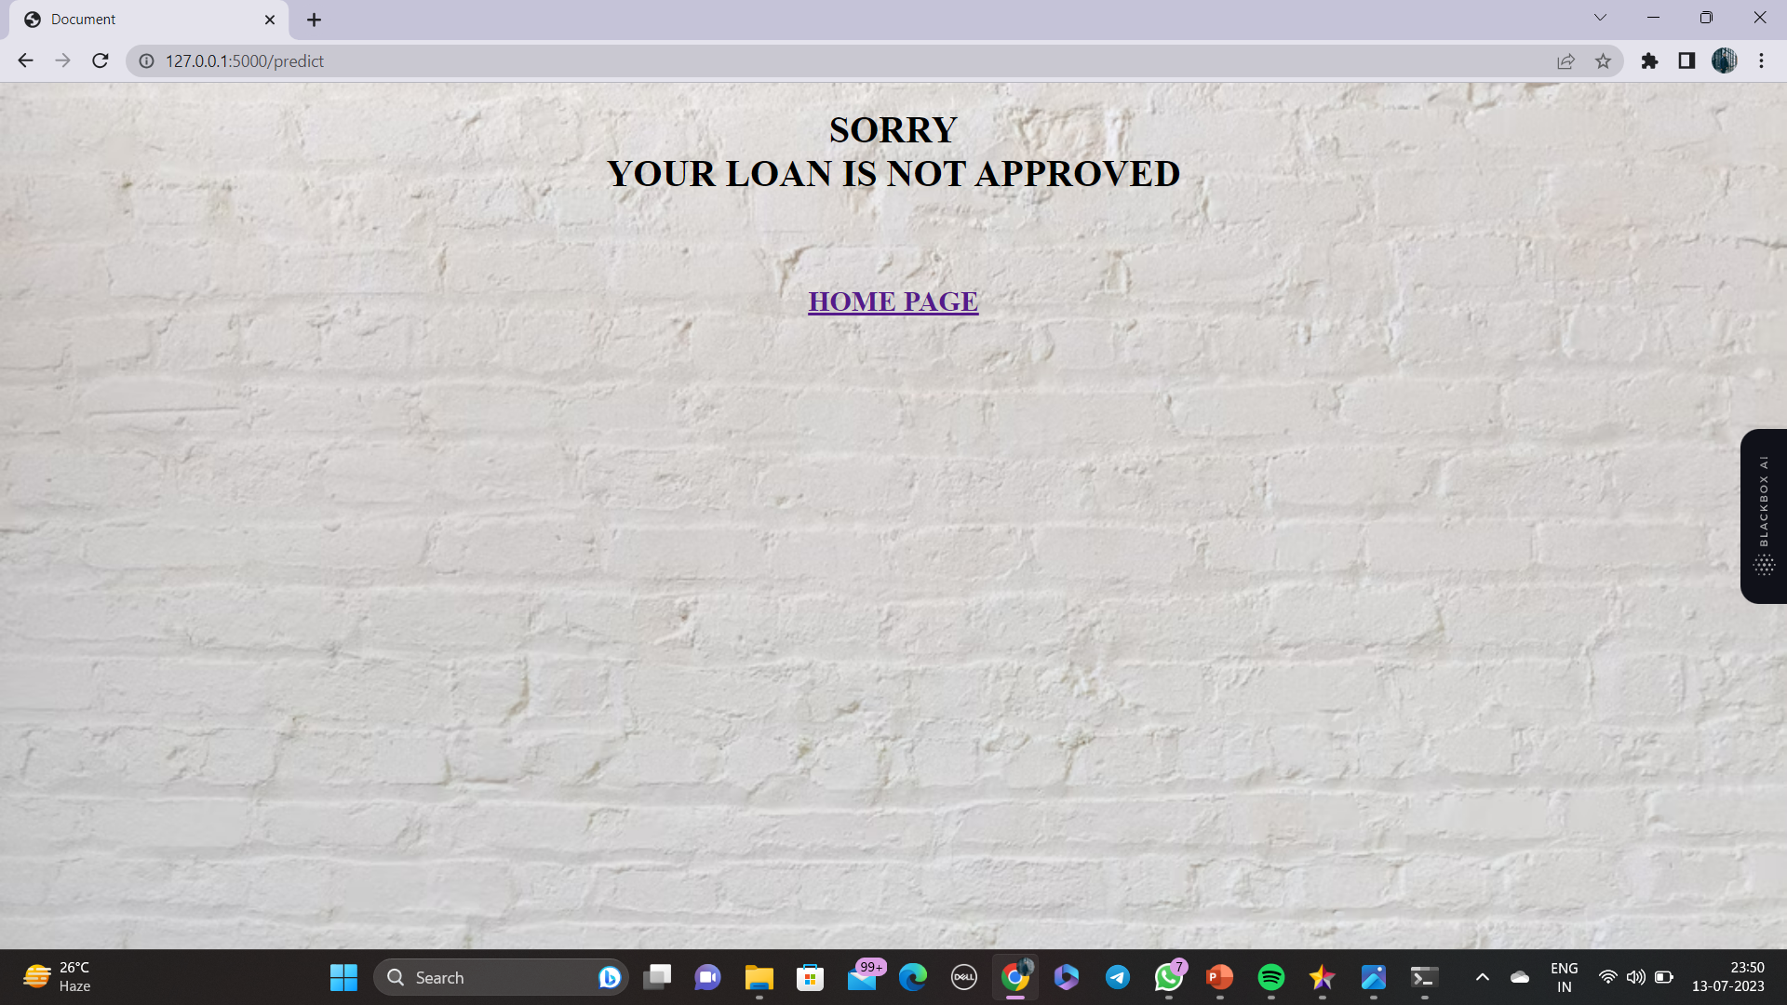

Slide 26
Conclusion:
From the abstract we focus on predicting the approval of loan using machine learning techniques.
By this we could able to tackle the problem.

Slide 27
References:
M. A. Sheikh, A. K. Goel and T. Kumar, "An Approach for Prediction of Loan Approval using Machine Learning Algorithm," 2020 International Conference on Electronics and Sustainable Communication Systems (ICESC), Coimbatore, India, 2020, pp. 490-494, doi: 10.1109/ICESC48915.2020.9155614.
Gurlove Singh, Amit Kumar Goel ,”Face Detection and Recognition System using Digital Image Processing” , 2nd International conference on Innovative Mechanism for Industry Application ICMIA 2020, 5-7 March 2020, IEEE Publisher.
Raj, J. S., Ananthi, J. V., “Recurrent neural networks and nonlinear prediction in support vector machine” Journal of Soft Computing Paradigm (JSCP),1(01), 33-40, 2019.
Aakanksha Saha, Tamara Denning, Vivek Srikumar, Sneha Kumar Kasera. ”Secrets in Source Code: Reducing False Positives using Machine Learning”, 2020 International Conference on Communication Systems Networks (COMSNETS), 2020.
Pidikiti Supriya, Myneedi Pavani, Nagarapu Saisushma, Namburi Vimala Kumari, k Vikash, “Loan Prediction by using Machine Learning Models”, International Journal of Engineering and Techniques. Volume 5 Issue 2, Mar-Apr 2019.

Slide 28
Any queries ?

Slide 29
Thank you

